Slide 1
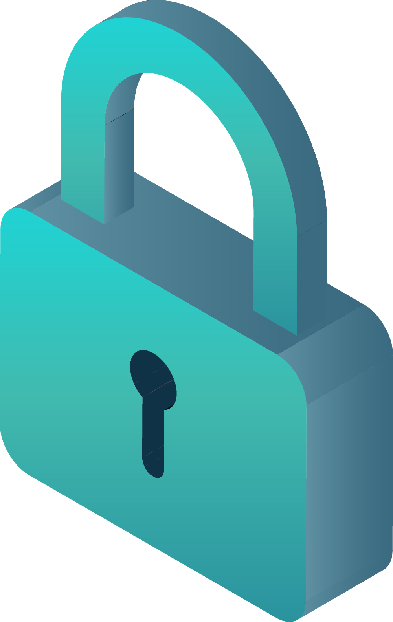



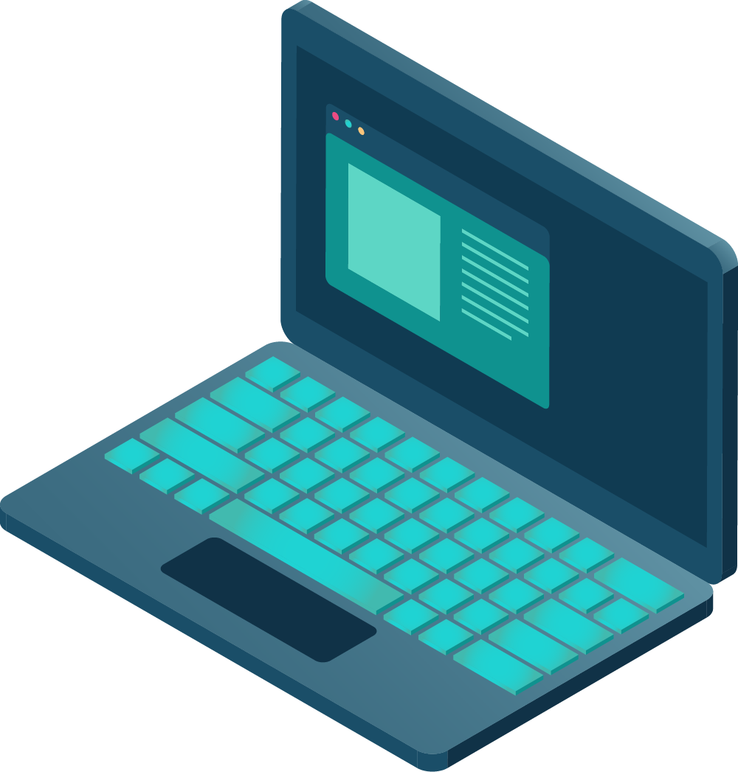

CYBERSECURITY
PRESENTED BY:
VISISHTHA. S
RAGAVI. K
BOOMIKA. M
NAKUL.. A

Slide 2
WHAT IS CYBERSECURITY ?
Cybersecurity refers to any technologies, practices and policies for preventing cyberattacks or mitigating their impact. Cybersecurity aims to protect computer systems, applications, devices, data, financial assets and people against ransomware and other malware, phishing scams, data theft and other cyberthreats.

Slide 3
CYBERSECURITY - DOMAINS
01
AI SECURITY
05
APPLICATION SECURITY
02
CRITICAL INFRASTRUCTURE SECURITY
06
CLOUD SECURITY
03
NETWORK SECURITY
07
INFORMATION SECURITY
04
ENDPOINT SECURITY
08
MOBILE SECURITY

Slide 4
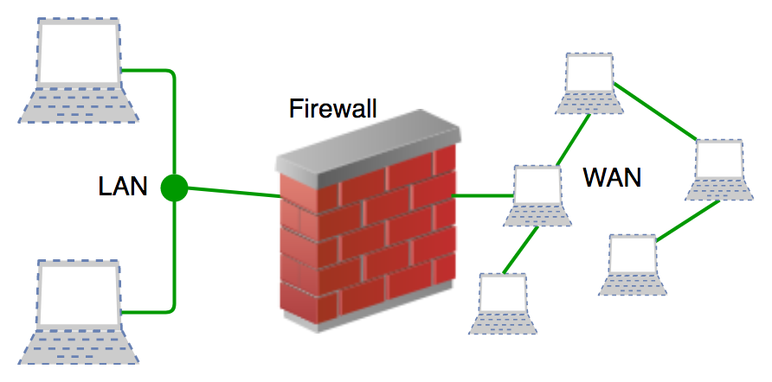
GENERATIONS
WHAT IS FIREWALL?
A firewall is a type of network security device that filters incoming and outgoing network traffic with security policies. A firewall is essentially the wall that separates a private internal network from the open Internet at its very basic level.
SIMPLE PACKET FILTERS
STATEFUL FIREWALLS
APPLICATION-LEVEL FIREWALLS
NGFWs (NEXT GENERATION FIREWALLS)

Slide 5

CYBER CRIME
Cybercrime is like the bad side of the internet, where criminals use tricks and technology to steal, cheat, or cause harm online. Think of it as a game between criminals and people trying to stop them.
EXAMPLES
PHISHING
RANSOMWARE
ONLINE FRAUD
CRYPTOJACKING
CYBERBULLYING

Slide 6
Hacking is when someone breaks into a computer, network, or device without permission to steal information, cause damage, or control the system. While some hackers do this for bad reasons, like stealing money or causing harm, others do it to find weakness in systems and helpmake them safer (ethical hacking).
SECURITY HACKING

Slide 7
METHODS OF HACKING
PHISHING
MALWARE
BRUTE FORCE ATTACK
SQL INJECTION
DoS AND DDoS
MitM ATTACKS
EXPLOITING ZERO-DAY VULNERABILITIES

Slide 8
PREVENTION AND PROTECTION
Use Strong Passwords
Enable Two-Factor Authentication
Keep Software Updated
Install Antivirus Software
Be Careful with Emails and Links
Use Firewalls
Back Up Your Data
Encrypt Sensitivity Information
Avoid Public Wi-Fi for Sensitive Tasks

Slide 9
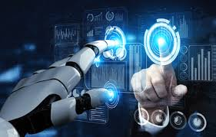
FUTURE ASPECTS
AI and Machine Learning
Automated Security
Zero Trust
Cloud Security
Quantum Computing
Biometric Security
IoT Security
Privacy Protection
More Cybersecurity job
Protecting Critical Infrastructure
Cybersecurity Services

Slide 10
THANK YOU!

